Slide 1

Master of Computer Application
University Institute of Technology
Rajiv Gandhi Proudyogiki Vishwavidyalaya
A
Minor Project
On
Digital Notice Board
Submitted By
Darakshan Khan
Tushar Chouragade
Tarun Rai
MCA (3 semester)

Slide 2

Contents
Introduction
Objective
Modules
Software Requirement
How its work?
E-R Diagram
Use Case Diagram
Block Diagram
Screenshot of Output
Advantages
Conclusion

Slide 3
Introduction of
Digital Notice Board
Digital Notice Board is used to convey the message to public, students or
employees through an ON-premise content management solution. One
can share the documents, PDF, images and video on daily basis for internal
or public communication

Slide 4
Objectives
The main objective of the system will be :
To develop a wireless technology for user.
2. To design simple user friendly system.
3. To easily keep track of notice board by the user with respect to date and time.
4. To develop a dynamic notice structure/model.

Slide 5
Modules
Add Notice
In this module user is going to add the notices. For adding notices, only the authenticate user will add the notices.
Update Notice
In this module user will update the notices. Updating of notice will be performing on the basis of search by title and date.
Delete Notice
In this module user will delete notice. Notices will get deleted on the basis of search by title and date.
Send Notice
It is mainly use for the sending notice to display on the notice board also scheduling will be performed using android on the basis of date and time.

Slide 6
Software Requirement
Java
XML (Extensible Markup Language)
Json (Javascript Object Notation)
IDE: Android Studio

Slide 7
How Its Work ?
Important Notices:
Digital notice board help to everyone updated on upcoming events, to the Opportunities Meeting holidays as well as today plan of lecture and you can also share the emergency news with student and teacher without hard work and in wasting time.
Welcome Message:
Any visiting dignitary or famous faculty is greeted by a welcome message on the day of arrival.
Achievements and Flash News:
If school or institute makes an important achievement or there is an important news, it can be flashed on the screen all over the campus.

Slide 8
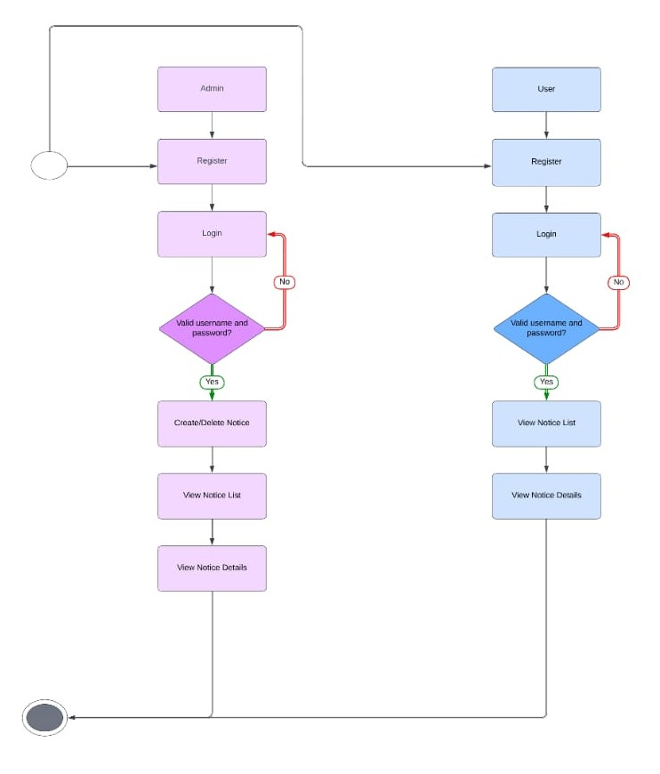
E-R Diagram

Slide 9
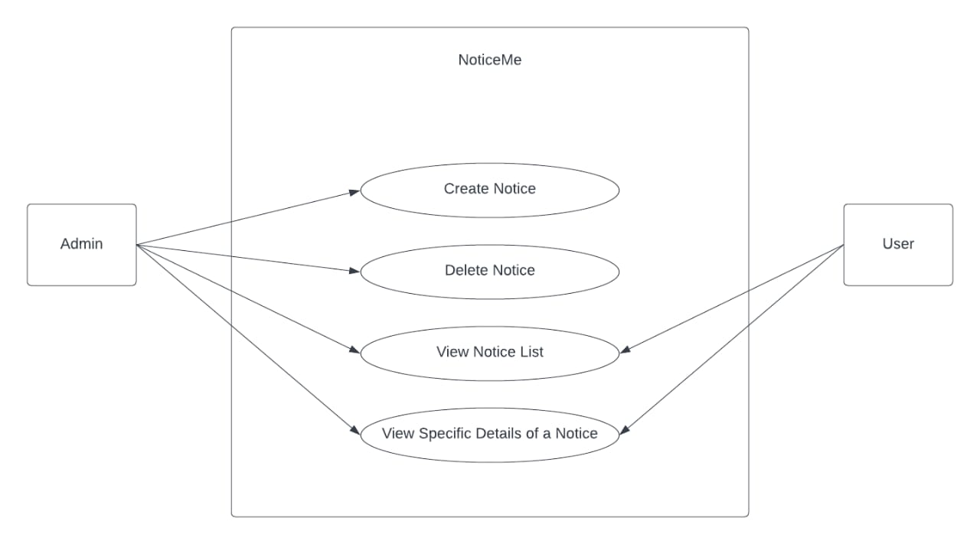
Use Case Diagram

Slide 10
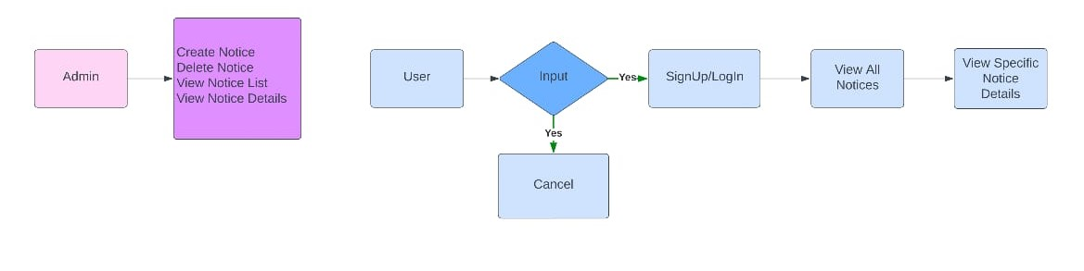
Block Diagram

Slide 11
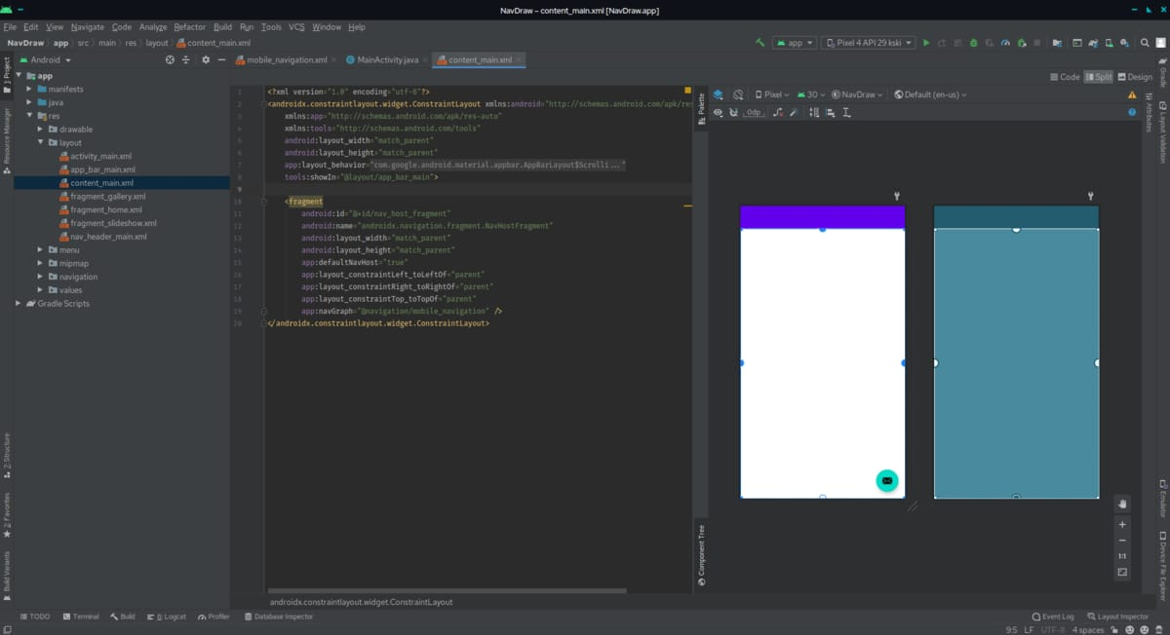
Screenshot of Output

Slide 12
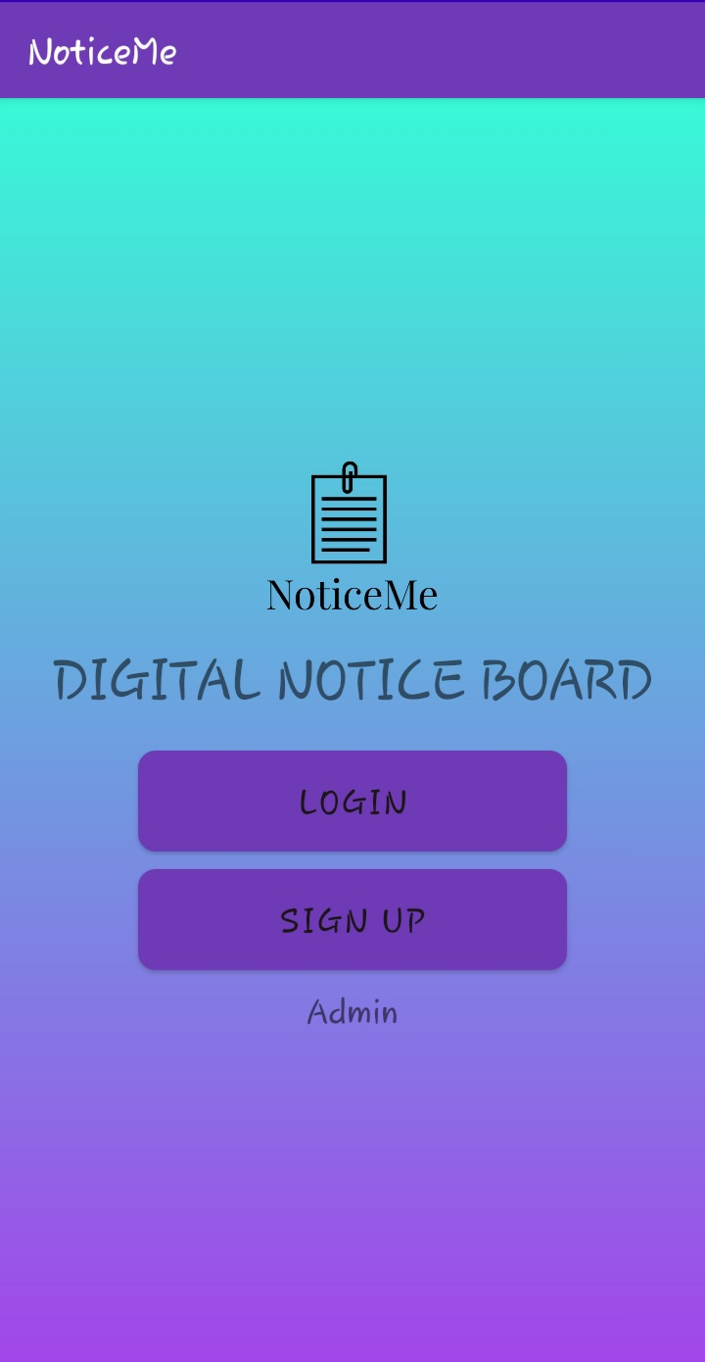
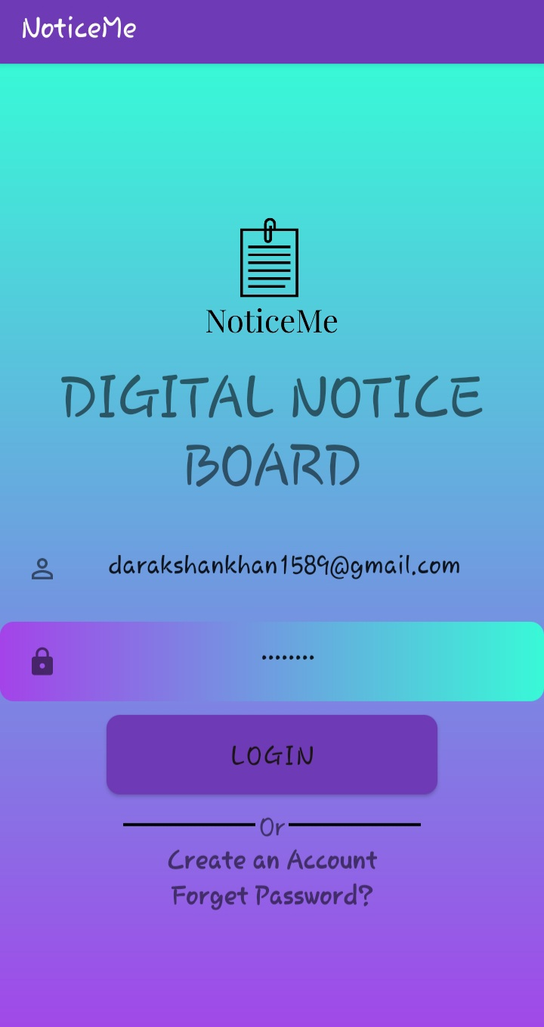
Admin Login Page

Slide 13
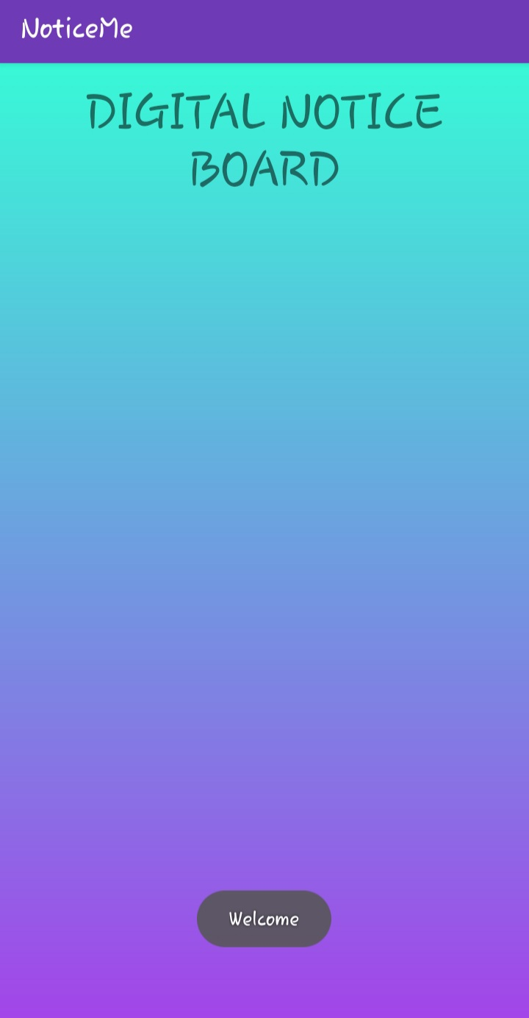
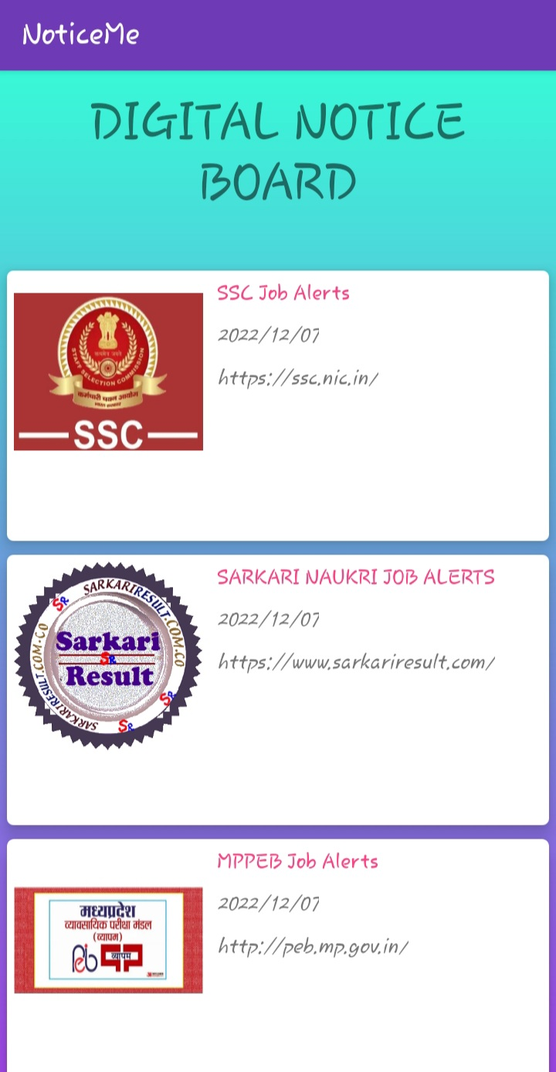
Add Notice

Slide 14
Advantages
The digital notice board are cost effective.
Digital notice board secure any information.
Easy to Use.

Slide 15
Conclusion
The proposed system deals about the design of smart and efficient notice board which is over comes the disadvantages of the existing notice system. It accepts the message, stores it, and displays it on the android application and also gives out voice announcements. It is an eco-friendly design. This project gives an effective method for showing messages or notice on digital notice board utilizing this digital technology.

Slide 16
Thank You

